Slide 1
My ASU Class Scheduling System
Team 5 Members: Lauren, Timothy, Ashlin & Naifeel

Slide 2
Table of Contents
Problem Statement and Project Objective
Background Research
Problems (Demons)
GDTA
Interview Questions
User Feedback
Dealing with Demons and System Modifications
Measures of Situational Awareness
Conclusion

Slide 3
Problem Statement and Project Objective
Problem Description: The existing class scheduling system (My ASU) suffers from inconsistency, UI design and interactivity issues.
Project Statement: As a part of our project we propose modifications to existing class scheduling system to improve facets of the human-machine interaction interface.
Objectives: Suggest potential modifications for the existing system to tackle the various UI design issues while simultaneously focusing on the following needs of the user:
Information Needs (Major maps, Course Info)
Scheduling Needs (Current Schedule, conflicts, constraints)
Consistency Needs (Consistency over various Operating Systems)

Slide 4
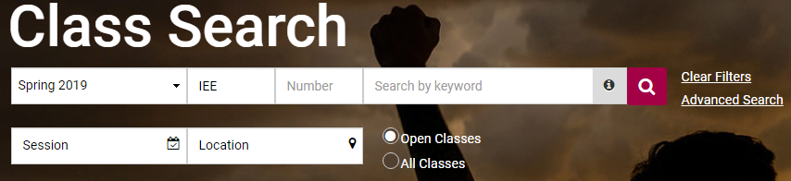
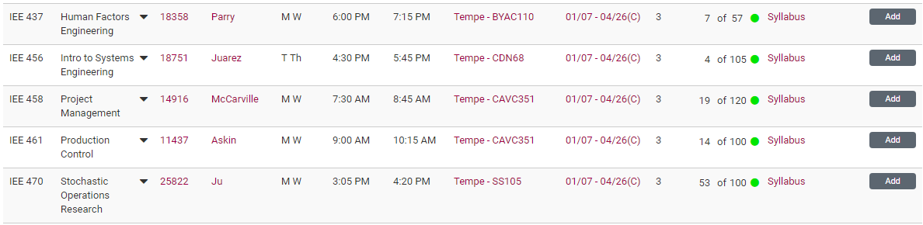
Background Research
Current System provides basic information such as:
Date/Time
Professor
Class Name
Available Seats
Location
Current schedule, searched classes and major map/dars are all on separate pages and have no connecting interactivity

Slide 5
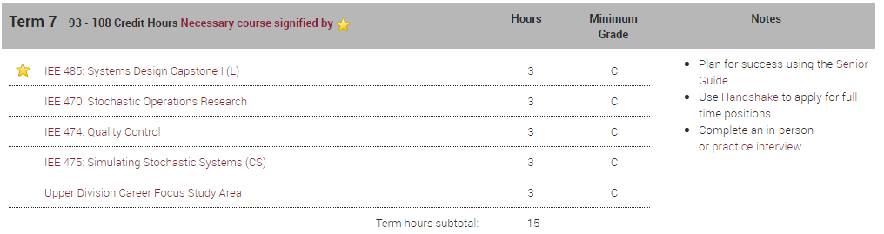
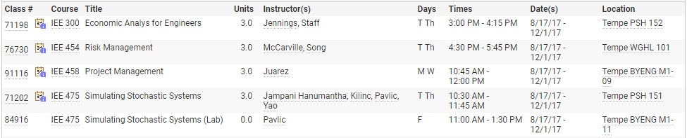

Slide 6
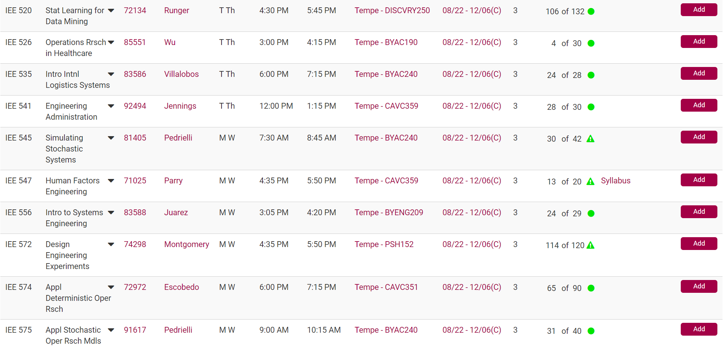
Problems
Problem 1: Need to remember a lot of information Demon: Requisite Memory Trap
It is hard to remember all the course numbers and different registration start times . These are applicable to both, the classes you intend to take as well as classes that are mandated by you to take in your coursework/current semester.

Slide 7
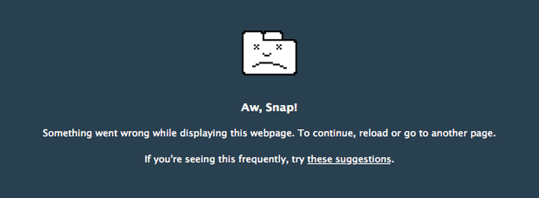
Problem 2: Heavy traffic when registration begins Demon: Fatigue, Anxiety, Other Stressors
Trying to add a class when the ASU website is overloaded because of heavy traffic can be stressful. It is easy to get anxious when a seat of the subject you desire to take is at stake.

Slide 8
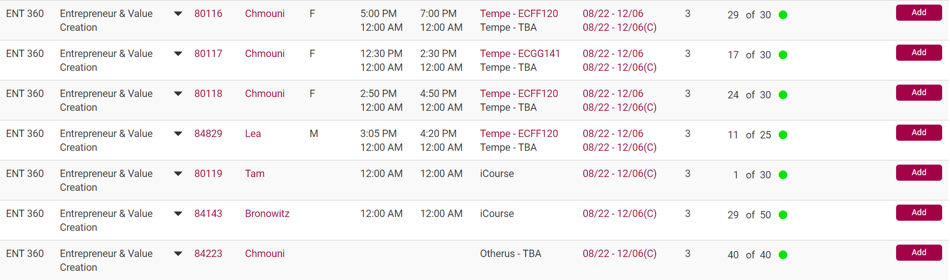
Problem 3: Hard to locate what specifically fits you and what you need Demon: Data Overload
Your searches often return you multiple options with classes having similar names and/or same subject codes. It can be hard figuring out the specific class you need to take.

Slide 9
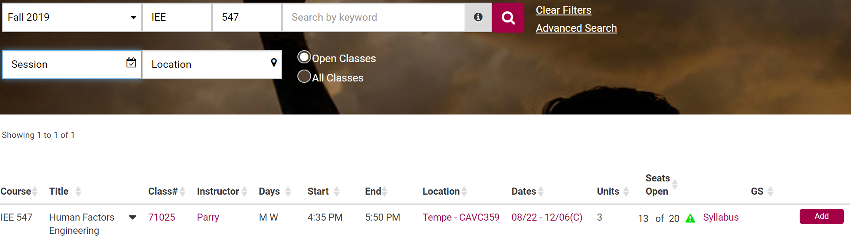
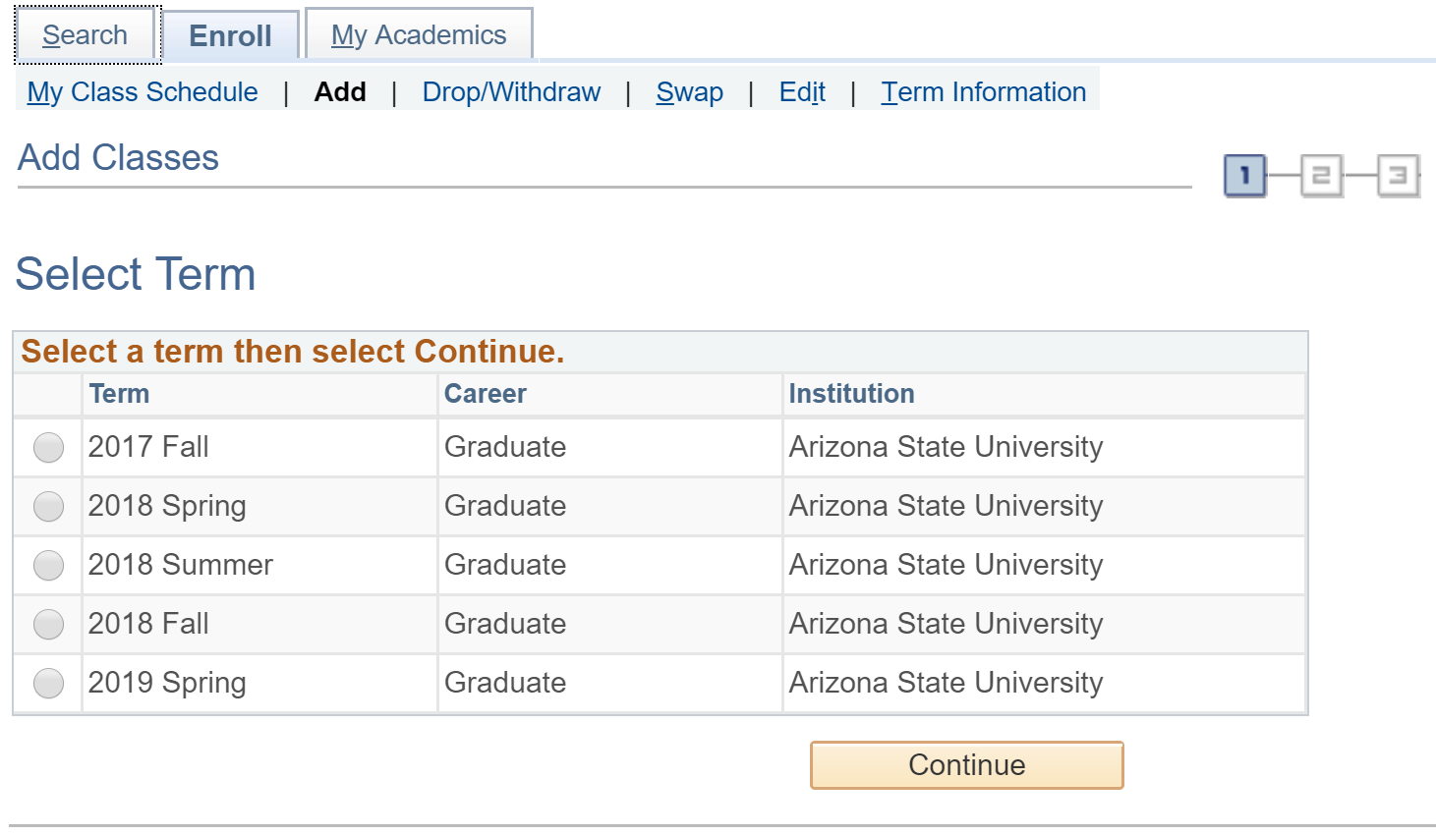
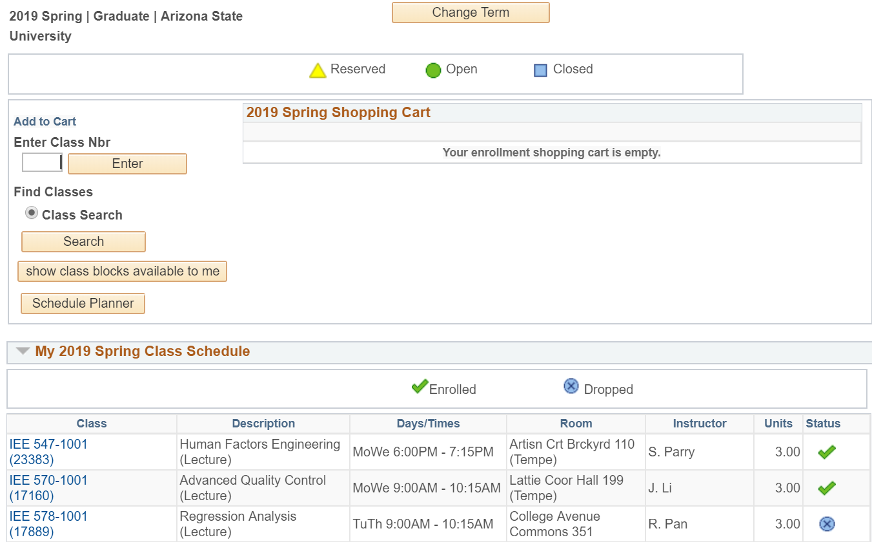
Problem 4: Complex process Demon: Complexity Creep
Things are all over the place and a lot of steps are required to add subjects. This can be a daunting experience for the new and inexperienced student.

Slide 10
Problem 5: No connecting interactivity Pain Point: Bad UI design/ Lack of Integration
No interactivity between various elements of the scheduling systems.

Slide 11
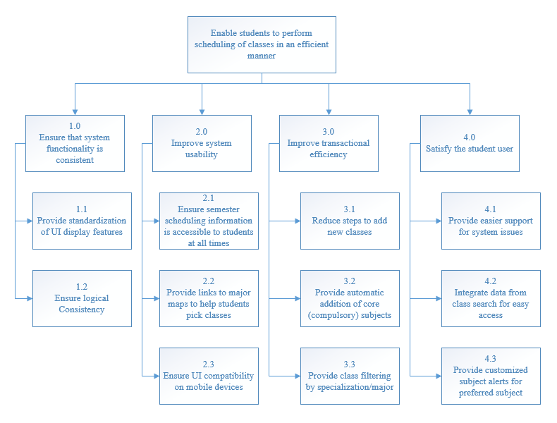
GDTA

Slide 12
GDTA
Major Goals
Based on the project objective, the major goals look to tackle the following areas of human-machine interaction:
System Consistency
System Usability
Transactional Efficiency
User Satisfaction Levels

Slide 13
Decisions and Information Needs
System Consistency
Sub-Goal: Provide standardization of UI features
Decision: What are the features that need to be standardized?
Information Needed: Common features users need access to
Sub-Goal: Ensure logical Consistency
Decision: How can the logic required to perform tasks be made consistent?
Information Needed: Logical steps user would take to perform common tasks
System Usability
Sub-Goal: Scheduling Information is Accessible
Decision: What is the best way to display the classes that the student is already enrolled in?
Information Needed: Feedback from students on how and where the information should be displayed
Sub-Goal: Major Map Information should be provided
Decision: What is the best way to provide this information?
Information Needed: Feedback from students on how this information can be shown
Transactional Efficiency
Sub-Goal: Reduce transaction steps
Decision: How many transactional steps are enough without taxing the user ?
Information Needed: Time taken to complete various common tasks so as to gauge transactional efficiency
Sub-Goal: Provide automatic addition of core classes
Decision: What is the best way to automate the system so as to not be disruptive to the user?
Information Needed: User feedback regarding what tasks can be automated with respect to class registration.
Customer Satisfaction
Sub-Goal: Easier support for system issues
Decision: What kind of support is capable of dealing with customer needs?
Information Needed: User feedback with regard to different support mechanisms
Sub-Goal: Facilitate Data Integration
Decision: How can data from different sources be integrated to prevent data overload?
Information Needed: Data requirements of user for common task execution

Slide 14
Interview Questions
What are the most common features that you as a user use?
Why are these features important you ?
Can you describe the process of adding classes?
What are the information requirements to add a class?
Where and how should this information be displayed?
How should major map information be displayed?
What kind of support mechanism do you prefer?
Can you describe the shortcomings of the current system?
What devices do you use to register for classes?
What are the anxiety triggers for the class registration process?
What part of the registration process needs to be automated?

Slide 15
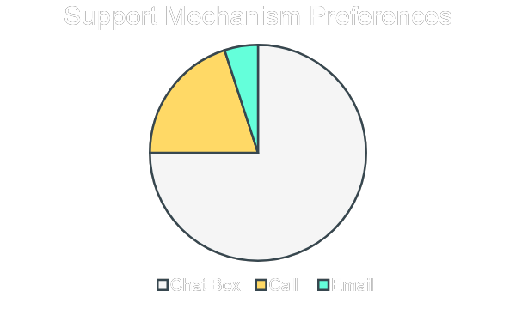
User Feedback Dashboard
Common Features
iPOS
Current Schedule
Major Map
Information Requirements
Scheduling Conflict Information
Major Map Information
Class Status
Pre-requisite Deficiencies
Registration process open for me
Operating Systems Used
iOS
macOS
Windows
Android
Support Mechanism Survey Results

Slide 16
Personas
The potential users of the system are going to be students of ASU. The functionality of the interface would be applicable to most users of the system and hence there is no new to split the potential user base into multiple personas. Now subtle differences regarding information requirements do arise depending on whether a student is a graduate or an undergraduate student. Those differences are represented below:
Design considerations to Address Differences: We have looked into making the interface universally applicable so all students can use it irrespective of them being an undergraduate or graduate student. If the iPos/Major Map functionality does not apply to a to a particular student, the system would automatically disable the function so as to avoid any confusion.
Type of Student | Exclusive Information Requirements
Undergraduate student | Major Maps
Graduate student | iPOS

Slide 17
Operational Scenarios
We have come up with two most commonly occurring operational scenarios. They have been documented below:
Operational Scenario 1: When there is high network traffic, the system gets bogged down and can slow down to a crawl. During this scenario the user needs to be given the option to access a lighter version of MyASU (basic HTML) to complete his/her class scheduling.
Operational Scenario 2: Often the short term memory reserves of the user can get overwhelmed when he/she starts the registration process. There is lot of information that he/she needs to keep in mind like major map information, current schedule and pre-requisites required. Due to sheer volume of information the user has to keep track of, there is high probability that an error would occur. Any good UI interface should provide all the information required in an uncluttered manner.

Slide 18
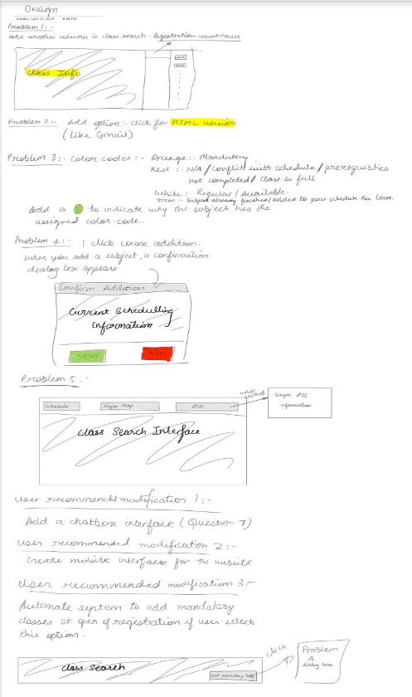
Initial Design Considerations (Mockups/Sketches)
We used brainstorming sessions, affinity diagrams, user feedback to come up with some preliminary sketches. Based on these initial mockups, we were able to modify the UI interface from a user centered perspective.

Slide 19
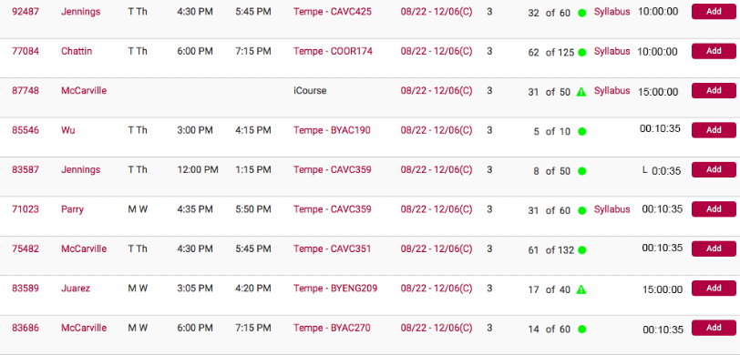
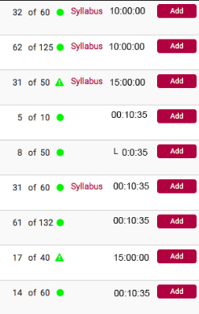
Dealing with the Demons and System Modifications
Solution for Problem 1 (Requisite Memory Trap)
The problem faced by users is the fact that they have to remember a lot of information before they can add a class to the checkout cart. This overreliance on short-term memory is bound to cause errors in the registration process. This SA demon has been negated using two design modifications given below:
Countdown Timers: The registration process starts on different days for a sophomore, junior, senior or a grad student and hence this can cause a lot of confusion especially if they are looking to register for the same course. To avoid confusion, we have incorporated a countdown timer that tells students when they can register for a particular class.
This countdown timer gives the user the time remaining before registration opens for the class. This way the user does not need to rely on information obtained from another tab before they can add the course to the registration cart.
Expanded View
Timer Close-up

Slide 20
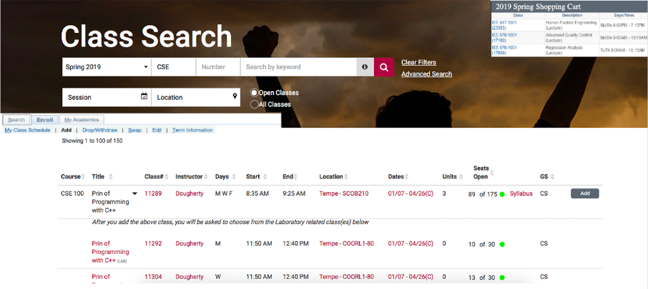
Solution for Problem 1 cont.…
Major Map Information and Scheduling Information: To reduce the load on the memory reserves of the user, we integrated major map and scheduling information all on the same interface so the user can look up the information required to register for a class easily.
The user can now view his/her current schedule and also access Major Maps from the same interface

Slide 21

Solution for Problem 2 (Fatigue, Anxiety and Other Stressors)
Based on the user feedback collected, it was identified that system users normally get stressed when the system crashes due to high network traffic. To deal with the stress caused by heavy network traffic, we are creating a HTML version or a lighter version of the Class Scheduling System that would load even when there is high network traffic.
By clicking on this link, a lighter version of the Class Scheduling System would be displayed.

Slide 22
Solution for Problem 3 (Data Overload)
The user can get overwhelmed by the sheer number of courses available on the Class Scheduling website. To simply the process and make the user better aware of what courses he/she needs to take, we are incorporating color coding and information buttons into the UI.
The user can find it difficult to keep track of the courses he/she has finished and the mandatory courses that are required for his/her major. This design modification provides the needed information using a simple color coding scheme.
Color Coding Scheme
Color | Significance
Orange | Courses that are compulsory and should be taken as soon as possible
Red | Courses that cannot be taken due to scheduling conflicts/pre-requisite deficiencies/class is at capacity
White | Courses that can be taken but are not compulsory
Green | Courses that have already been taken or are currently being taken

Slide 23
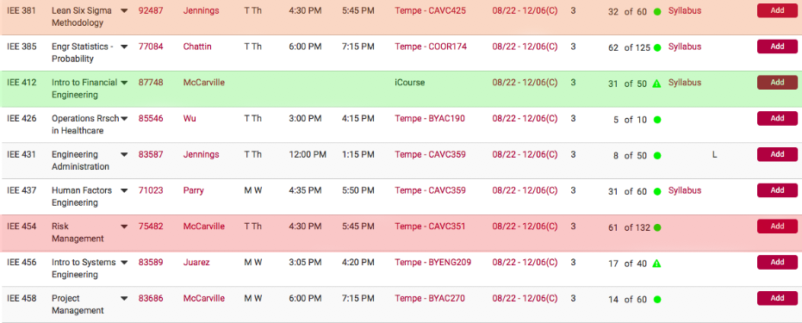
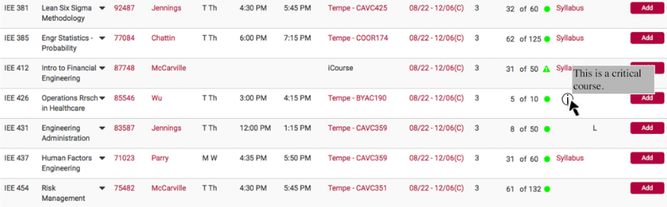
Solution for Problem 3 cont.…
Color Coding
Information Buttons

Slide 24
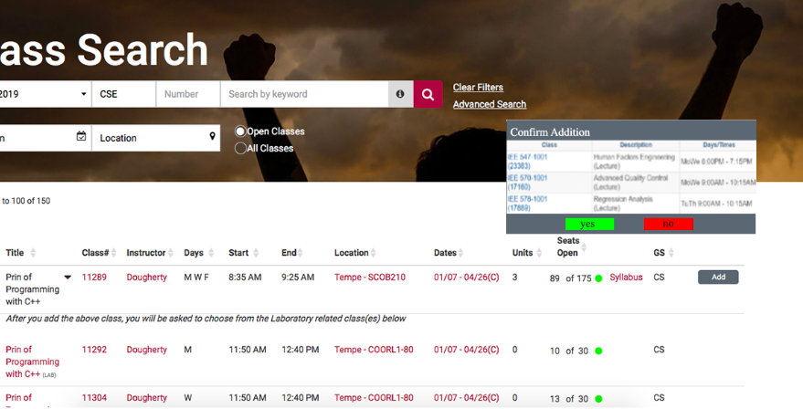
Solution for Problem 4 (Complexity Creep)
User feedback indicated that a more easier checkout process was the need of the hour. To accomplish this, we created a one-click course registration process, where the class registration process can all be completed in one interface and in 2 easy steps.
Course addition is now possible in 2 steps:
Click Add
Confirm Course that needs to be added.

Slide 25
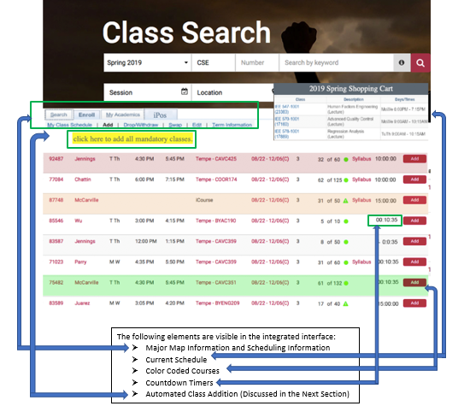
Solution for Problem 5 (Lack of System Integration)
The goal of the modified system was to provide an integrated interface that provided all the required information on the same screen without the system getting too cluttered. Modifications made to the existing system to achieve that goal are displayed below.

Slide 26
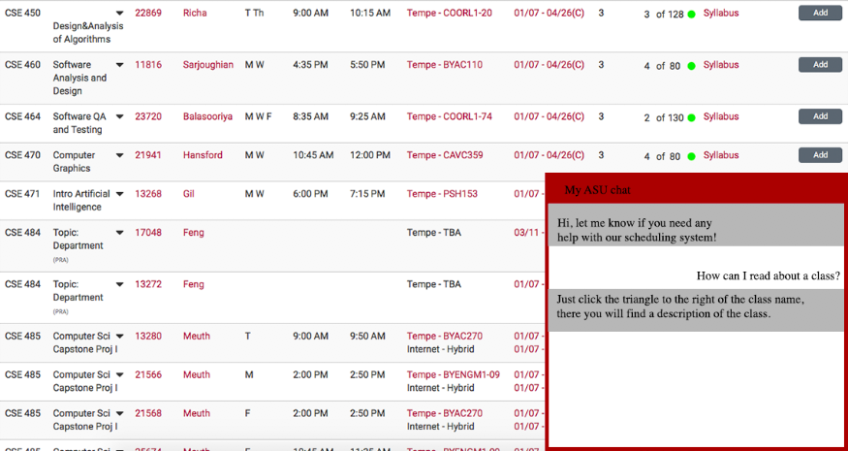
Additional System Modifications
Support Mechanism
Based on the user feedback obtained, most users of the class scheduling system indicated the need for a support system. A chat based system received high user preference among many potential support mechanisms. Keeping the user in mind, we have designed a chat interface that provides user support 24/7.
We aim to provide comprehensive support 24/7 using the chat interface above.

Slide 27

Mobile Interface
Using the user feedback obtained, we have identified that there indeed is a need for a mobile based platform for the scheduling system. In accordance with these user requirements, we have created a mobile platform that performs the same functionality as the desktop system thus giving user full system functionality and portability.
The Mobile App can be used on iOS, as well as Android and offers full functionality.

Slide 28
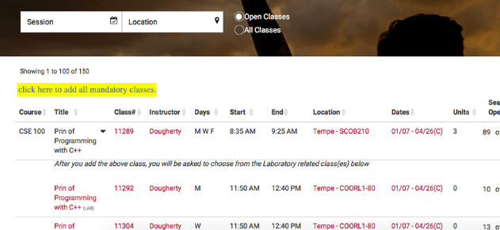
System Automation
Most system users indicated that automation would be particularly useful in automating the repetitive tasks of the system. This is especially true, when you have multiple mandatory classes that you need to add for the particular semester. To automate this repetitive process, we have created an option that allows you to automate the addition of all mandatory classes with the click of a button. The process is completed in 2 stages represented below.
Step 1
Step 2

Slide 29
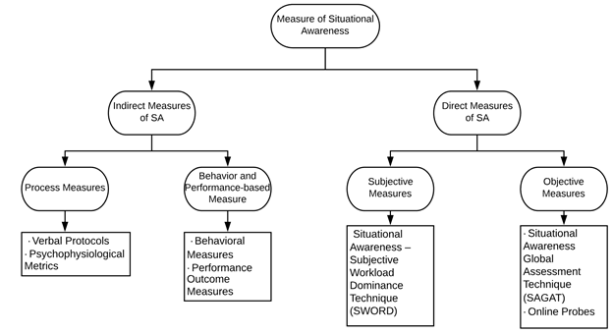
Measures of Situational Awareness
Applicable measures of Situational Awareness

Slide 30
Important SA Measures:
Indirect Measures of SA: ·
Verbal Protocols: This is done by running commentaries in which the students verbally describe their thoughts, strategies, and decisions while interacting with myASU’ class scheduling system. This information can be recorded and later analyzed to identify and categorize information relevant to the individual’s SA. Although these provide much insight into the way the student conceptualized a task and the cognitive processes employed, analyzing verbal protocols can be difficult due to their time incentive and subjective nature of the analysis.
Direct Measures of SA:
Online Probes: This technique of measuring SA requires us to prepare a series of questions covering the entire range of students’ SA needs and present it to the student to answer. Response time to these questions is a measure of the student’s SA.

Slide 31
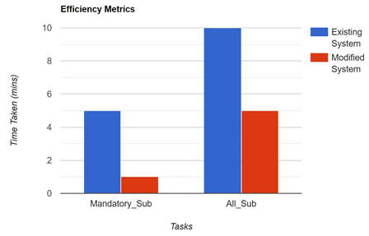
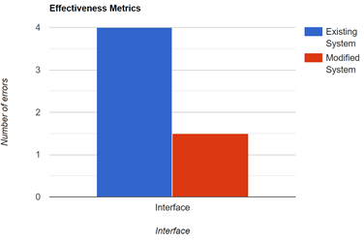
System Test and Evaluation:
Efficiency Metrics:
This metric evaluates the time a student takes to perform basic tasks such as adding mandatory classes and adding all classes. The bar-chart below shows estimated values of these time taken to perform their corresponding tasks.
Effectiveness Metrics:
This metric evaluates the errors made by a student while scheduling classes. The bar chart below shows an estimation of the errors made by students.

Slide 32
Conclusion
The problem was initially documented, and design objectives were outlined. Background Research was done, and the different modes/functionality of the existing system was presented in a detailed manner. Problems with the existing UI and the SA demons associated with these problems were also recorded.
To get a picture of the cognitive process a system user goes through, Goal Directed Task Analysis (GDTA) was performed. Next, user feedback was obtained to gather potential solution strategies. Feasibility and alignment with GDTA were two main objectives that were looked at while brainstorming potential solutions.
Once the solutions strategies were finalized, the existing system was modified so as to match user preferences and to enhance user experience. All modifications have been documented in detail. Measures of SA were also looked into and those findings chronicled in the penultimate section of the report.

